Slide 1
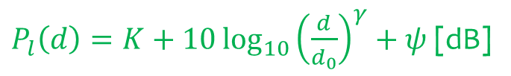
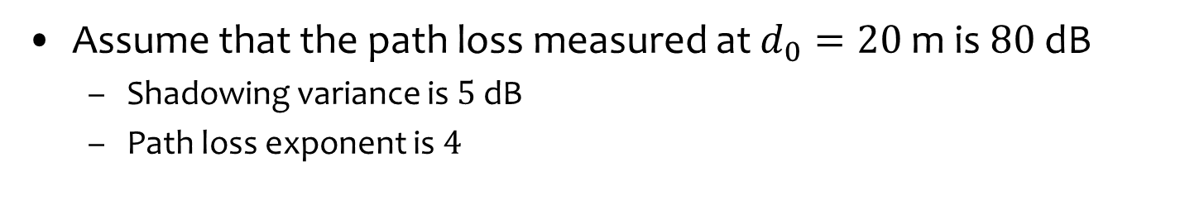
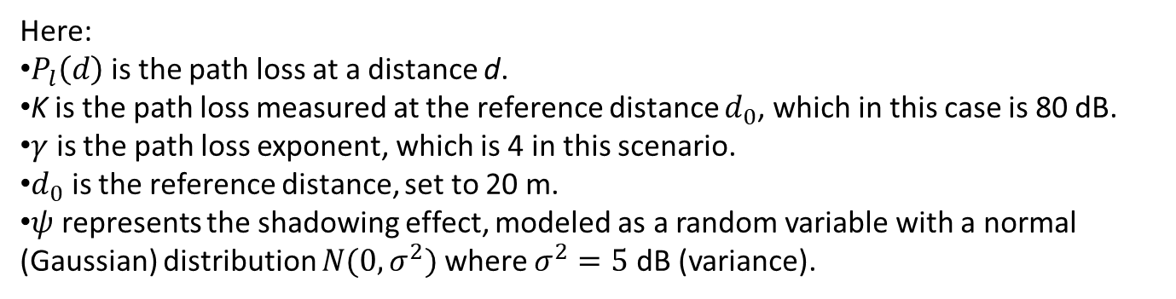


Question 1
Assume that the path loss measured at $d_{0}=20$ m is $80$ dB
Shadowing variance is $5$ dB
Path loss exponent is $4$
Express the simplified path loss model including shadowing
$P_{l}\left(d\right)=K+10\log_{10}{{\left(\frac{d}{d_{0}}\right)}^{γ}}+ψ$ [dB]
$$ψ\sim 𝒩(0,σ^{2}=5)$$
$=80+40\log_{10}\left(d\right)−40\log_{10}\left(20\right)$ $+ψ$ [dB]
Here:
$P_{l}​\left(d\right)$is the path loss at a distance d.
K is the path loss measured at the reference distance $d_{0}$​, which in this case is 80 dB.
$γ$ is the path loss exponent, which is 4 in this scenario.
$d_{0}$​ is the reference distance, set to 20 m.
$ψ$ represents the shadowing effect, modeled as a random variable with a normal (Gaussian) distribution $N(0,σ^{2})$where $σ^{2}=5$ dB (variance).

Slide 2
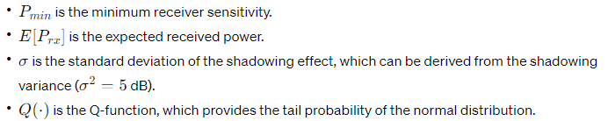
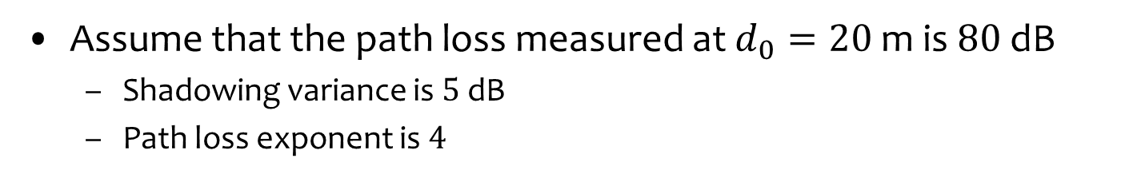


Question 1
Assume that the path loss measured at $d_{0}=20$ m is $80$ dB
Shadowing variance is $5$ dB
Path loss exponent is $4$
Assume that the transmit power is $1$ Watts and the receiver sensitivity is $−80$ dBm. What is the outage probability at $d=100$ meters?
$$E\left[P_{rx}\right]=P_{tx}−P_{l}\left(d\right)=10\log{1000}−\left(80+40\log_{10}\left(d\right)−40\log_{10}\left(20\right)\right)$$
$$p_{outage}\left(d\right)=\operatorname{Pr}\left\{P_{rx}\left(d\right)<P_{min}\right\}=1−Q\left(\frac{P_{min}−\left(E\left[P_{rx}\right]\right)}{σ}\right)=0.1807$$
$$σ^{2}=5$$

Slide 3
Question 1
Assume that the path loss measured at $d_{0}=20$ m is $80$ dB
Shadowing variance is $5$ dB
Path loss exponent is $4$
Propose three methods that can improve the coverage rate?
Increase the receiver and the transmitter heights (i.e., lower the exponent)
Decrease the carrier frequency
Decrease the receiver sensitivity with a better modulation

Slide 4
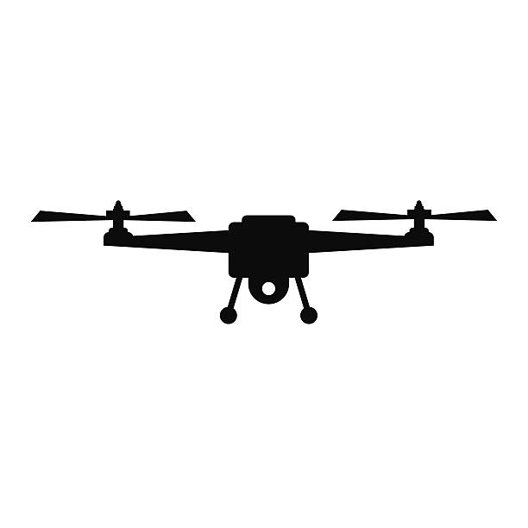
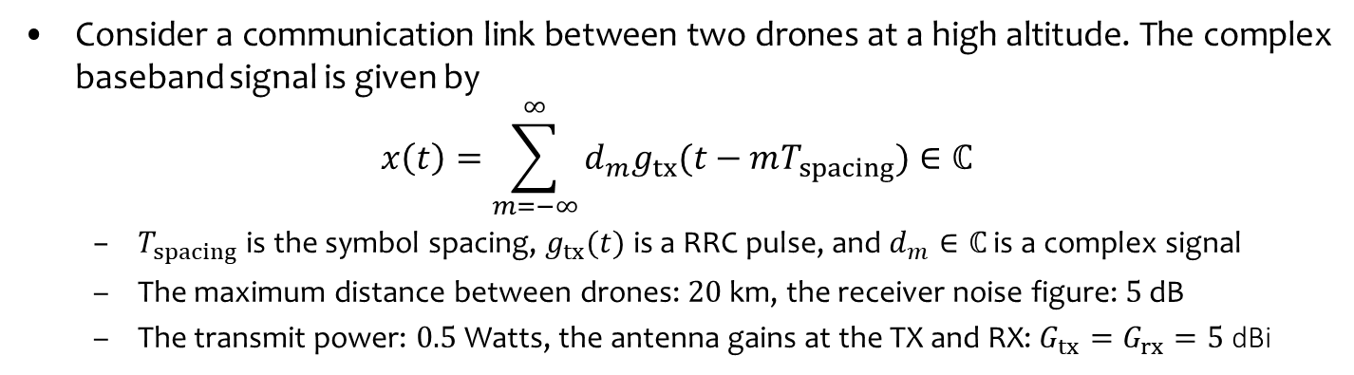


Question 2
Consider a communication link between two drones at a high altitude. The complex baseband signal is given by
$$x\left(t\right)=\sum_{m=−∞}^{∞}{d_{m}g_{tx}(t−mT_{spacing})}∈ℂ$$
$T_{spacing}$ is the symbol spacing, $g_{tx}(t)$ is a RRC pulse, and $d_{m}∈ℂ$ is a complex signal
The maximum distance between drones: $20$ km, the receiver noise figure: $5$ dB
The transmit power: $0.5$ Watts, the antenna gains at the TX and RX: $G_{tx}=G_{rx}=5$ dBi
What is the transmit power in dBm?
$$P_{tx}=10\log_{10}{500 mW}=27 dBm$$
$$f_{c}=2.4 GHz$$
$$B=20 MHz$$

Slide 5
Question 2
Consider a communication link between two drones at a high altitude. The complex baseband signal is given by
$$x\left(t\right)=\sum_{m=−∞}^{∞}{d_{m}g_{tx}(t−mT_{spacing})}∈ℂ$$
$T_{spacing}$ is the symbol spacing, $g_{tx}(t)$ is a RRC pulse, and $d_{m}∈ℂ$ is a complex signal
The maximum distance between drones: $20$ km, the receiver noise figure: $5$ dB
The transmit power: $0.5$ Watts, the antenna gains at the TX and RX: $G_{tx}=G_{rx}=5$ dBi
What is the received signal power in dBm based on the free-space path loss model?
$P_{rx}\left[dBm\right]=P_{tx}\left[dBm\right]−PL\left[dB\right]=30[dBm]−PL[dB]$
$$PL=20\log_{10}\left(d\right)+20\log_{10}\left(f_{c}\right)−147.55−G_{tx}−G_{rx}=116[dB]$$
$$P_{rx}\left[dBm\right]=27\left[dBm\right]−116\left[dB\right]=−89 dBm$$
$$f_{c}=2.4 GHz$$
$$B=20 MHz$$

Slide 6
Question 2
Consider a communication link between two drones at a high altitude. The complex baseband signal is given by
$$x\left(t\right)=\sum_{m=−∞}^{∞}{d_{m}g_{tx}(t−mT_{spacing})}∈ℂ$$
$T_{spacing}$ is the symbol spacing, $g_{tx}(t)$ is a RRC pulse, and $d_{m}∈ℂ$ is a complex signal
The maximum distance between drones: $20$ km, the receiver noise figure: $5$ dB
The transmit power: $0.5$ Watts, the antenna gains at the TX and RX: $G_{tx}=G_{rx}=5$ dBi
What is the noise power in dBm? (kT = -174 dBm/Hz)
$$B=20 MHz⇒P_{noise}\left[dBm\right]=kT+10\log_{10}{B}+NF=−96 dBm$$
$$f_{c}=2.4 GHz$$
$$B=20 MHz$$

Slide 7
Question 2
Consider a communication link between two drones at a high altitude. The complex baseband signal is given by
$$x\left(t\right)=\sum_{m=−∞}^{∞}{d_{m}g_{tx}(t−mT_{spacing})}∈ℂ$$
$T_{spacing}$ is the symbol spacing, $g_{tx}(t)$ is a RRC pulse, and $d_{m}∈ℂ$ is a complex signal
The maximum distance between drones: $20$ km, the receiver noise figure: $5$ dB
The transmit power: $0.5$ Watts, the antenna gains at the TX and RX: $G_{tx}=G_{rx}=5$ dBi
What is the SNR in dB?
$$SNR\left[dB\right]=P_{rx}\left[dB\right]−P_{noise}\left[dBm\right]=−89 dBm+96 dBm=7 dB$$
$$f_{c}=2.4 GHz$$
$$B=20 MHz$$

Slide 8
Question 2
Consider a communication link between two drones at a high altitude. The complex baseband signal is given by
$$x\left(t\right)=\sum_{m=−∞}^{∞}{d_{m}g_{tx}(t−mT_{spacing})}∈ℂ$$
$T_{spacing}$ is the symbol spacing, $g_{tx}(t)$ is a RRC pulse, and $d_{m}∈ℂ$ is a complex signal
The maximum distance between drones: $20$ km, the receiver noise figure: $5$ dB
The transmit power: $0.5$ Watts, the antenna gains at the TX and RX: $G_{tx}=G_{rx}=5$ dBi
What is the channel capacity?
$$R≤C=B\log_{2}\left(1+SNR\left[lin\right]\right)=20e6\log_{2}\left(1+{10}^{\frac{7}{10}}\right)=51.2 Mbit/s$$
$$f_{c}=2.4 GHz$$
$$B=20 MHz$$

Slide 9

Question 2
Consider a communication link between two drones at a high altitude. The complex baseband signal is given by
$$x\left(t\right)=\sum_{m=−∞}^{∞}{d_{m}g_{tx}(t−mT_{spacing})}∈ℂ$$
$T_{spacing}$ is the symbol spacing, $g_{tx}(t)$ is a RRC pulse, and $d_{m}∈ℂ$ is a complex signal
The maximum distance between drones: $20$ km, the receiver noise figure: $5$ dB
The transmit power: $0.5$ Watts, the antenna gains at the TX and RX: $G_{tx}=G_{rx}=5$ dBi
If the pulse shape $g_{tx}\left(t\right)$ is root-raised cosine with the roll-off factor of $0.2$, what should be $T_{spacing}$?
$$B=\frac{1+ρ}{T_{spacing}}⇒T_{spacing}=\frac{1+ρ}{B}=\frac{1+0.2}{20 MHz}=60 ns$$
$$f_{c}=2.4 GHz$$
$$B=20 MHz$$

Slide 10

Question 2
Consider a communication link between two drones at a high altitude. The complex baseband signal is given by
$$x\left(t\right)=\sum_{m=−∞}^{∞}{d_{m}g_{tx}(t−mT_{spacing})}∈ℂ$$
$T_{spacing}$ is the symbol spacing, $g_{tx}(t)$ is a RRC pulse, and $d_{m}∈ℂ$ is a complex signal
The maximum distance between drones: $20$ km, the receiver noise figure: $5$ dB
The transmit power: $0.5$ Watts, the antenna gains at the TX and RX: $G_{tx}=G_{rx}=5$ dBi
If the pulse shape $g_{tx}\left(t\right)$ is root-raised cosine with the roll-off factor of $0.2$, what is the symbol rate?
$$R_{symbol}=\frac{1}{T_{spacing}}=\frac{1}{60 ns}=16.67e6 symbols/sec$$
$$f_{c}=2.4 GHz$$
$$B=20 MHz$$

Slide 11

Question 2
Consider a communication link between two drones at a high altitude. The complex baseband signal is given by
$$x\left(t\right)=\sum_{m=−∞}^{∞}{d_{m}g_{tx}(t−mT_{spacing})}∈ℂ$$
$T_{spacing}$ is the symbol spacing, $g_{tx}(t)$ is a RRC pulse, and $d_{m}∈ℂ$ is a complex signal
The maximum distance between drones: $20$ km, the receiver noise figure: $5$ dB
The transmit power: $0.5$ Watts, the antenna gains at the TX and RX: $G_{tx}=G_{rx}=5$ dBi
If we want to reach $50$ Mbps for the bit rate, how many bits need to be carried per data symbol?
$$\frac{\# of bits}{symbol}≥\frac{R_{bits}}{R_{symbol}}=\frac{50e6}{1.67e6}=3 bit/sym$$
$$f_{c}=2.4 GHz$$
$$B=20 MHz$$

Slide 12
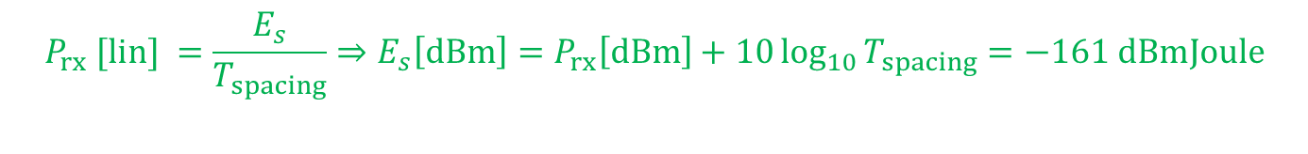
Question 2
Consider a communication link between two drones at a high altitude. The complex baseband signal is given by
$$x\left(t\right)=\sum_{m=−∞}^{∞}{d_{m}g_{tx}(t−mT_{spacing})}∈ℂ$$
$T_{spacing}$ is the symbol spacing, $g_{tx}(t)$ is a RRC pulse, and $d_{m}∈ℂ$ is a complex signal
The maximum distance between drones: $20$ km, the receiver noise figure: $5$ dB
The transmit power: $0.5$ Watts, the antenna gains at the TX and RX: $G_{tx}=G_{rx}=5$ dBi
Calculate the energy received per data symbol and the noise density
$$P_{rx} [lin] =\frac{E_{s}}{T_{spacing}}⇒E_{s}\left[dBm\right]=P_{rx}\left[dBm\right]+10\log_{10}{T_{spacing}}=−161 dBmJoule$$
$$P_{noise} [lin] =\frac{N_{0}}{T_{spacing}}⇒N_{0}\left[dBm\right]=P_{noise}\left[dBm\right]+10\log_{10}{T_{spacing}}=−168dBmJoule$$
$$f_{c}=2.4 GHz$$
$$B=20 MHz$$

Slide 13




Question 2
Consider a communication link between two drones at a high altitude. The complex baseband signal is given by
$$x\left(t\right)=\sum_{m=−∞}^{∞}{d_{m}g_{tx}(t−mT_{spacing})}∈ℂ$$
$T_{spacing}$ is the symbol spacing, $g_{tx}(t)$ is a RRC pulse, and $d_{m}∈ℂ$ is a complex signal
The maximum distance between drones: $20$ km, the receiver noise figure: $5$ dB
The transmit power: $0.5$ Watts, the antenna gains at the TX and RX: $G_{tx}=G_{rx}=5$ dBi
What are the bit error rate & data rate if we use on-off keying? Give an example bit mapping for OOK
$$\frac{E_{s}}{N_{0}}\left[dB\right]=−161−\left(−168\right)=7 [dB]$$
$$Bit 0⇒0, Bit 1⇒\sqrt{2}$$
$$P_{err}=Q\left(\sqrt{\frac{E_{s}}{N_{0}}}\right)=Q\left(\sqrt{{10}^{7/10}}\right)=0.013$$
$$R_{bit}=\frac{1}{T_{spacing}}=16.67 Mbit/s$$
$$f_{c}=2.4 GHz$$
$$B=20 MHz$$

Slide 14
Question 2
Consider a communication link between two drones at a high altitude. The complex baseband signal is given by
$$x\left(t\right)=\sum_{m=−∞}^{∞}{d_{m}g_{tx}(t−mT_{spacing})}∈ℂ$$
$T_{spacing}$ is the symbol spacing, $g_{tx}(t)$ is a RRC pulse, and $d_{m}∈ℂ$ is a complex signal
The maximum distance between drones: $20$ km, the receiver noise figure: $5$ dB
The transmit power: $0.5$ Watts, the antenna gains at the TX and RX: $G_{tx}=G_{rx}=5$ dBi
Would the shadowing variance be large or small for this communication channel? Why?
Most likely low because there are less obstacles between the drones
$$f_{c}=2.4 GHz$$
$$B=20 MHz$$

Slide 15
Question 2
Consider a communication link between two drones at a high altitude. The complex baseband signal is given by
$$x\left(t\right)=\sum_{m=−∞}^{∞}{d_{m}g_{tx}(t−mT_{spacing})}∈ℂ$$
$T_{spacing}$ is the symbol spacing, $g_{tx}(t)$ is a RRC pulse, and $d_{m}∈ℂ$ is a complex signal
The maximum distance between drones: $20$ km, the receiver noise figure: $5$ dB
The transmit power: $0.5$ Watts, the antenna gains at the TX and RX: $G_{tx}=G_{rx}=5$ dBi
Is it better to model the small-scale fading with Rayleigh or Rician? Why?
Rician because it is likely that there is line-of-sight path
$$f_{c}=2.4 GHz$$
$$B=20 MHz$$

Slide 16

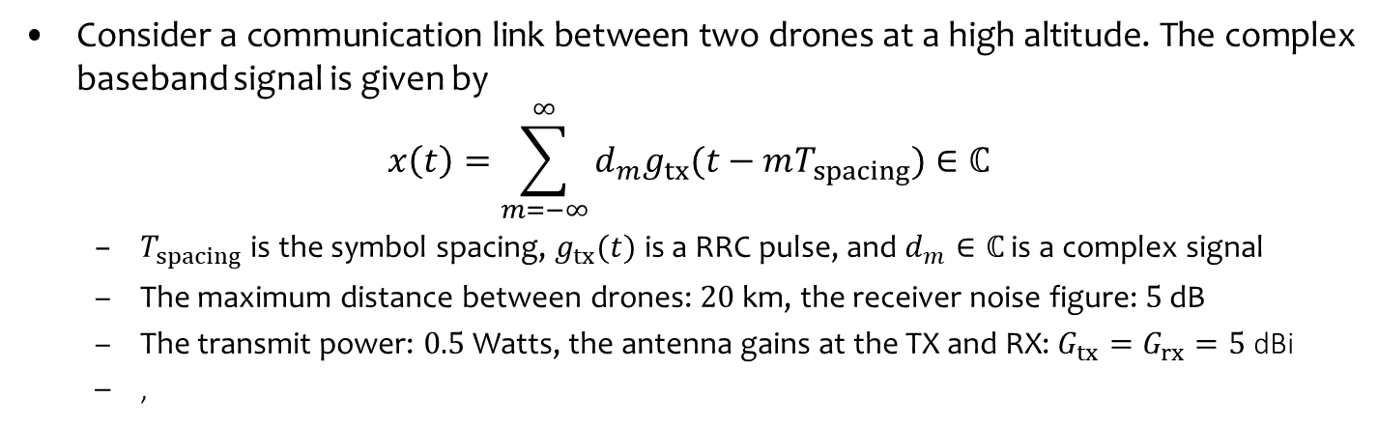
Question 2
Consider a communication link between two drones at a high altitude. The complex baseband signal is given by
$$x\left(t\right)=\sum_{m=−∞}^{∞}{d_{m}g_{tx}(t−mT_{spacing})}∈ℂ$$
$T_{spacing}$ is the symbol spacing, $g_{tx}(t)$ is a RRC pulse, and $d_{m}∈ℂ$ is a complex signal
The maximum distance between drones: $20$ km, the receiver noise figure: $5$ dB
The transmit power: $0.5$ Watts, the antenna gains at the TX and RX: $G_{tx}=G_{rx}=5$ dBi
,
Assume that drones are approaching each other. The speed of each drone is 200 meters/sec. What is the carrier frequency that the receiver observes?
If the total velocity is $2v=400 m/s$, the Doppler shift is $f_{d}=400×\frac{f_{c}}{c}=3.2$ kHz
$$f_{rx}=2.4 GHz+f_{d}$$
$$f_{c}=2.4 GHz$$
$$B=20 MHz$$

Slide 17
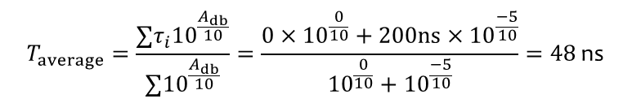

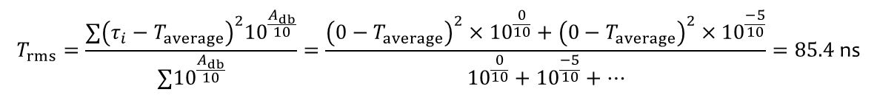
Question 2
Consider a communication link between two drones at a high altitude. The complex baseband signal is given by
$$x\left(t\right)=\sum_{m=−∞}^{∞}{d_{m}g_{tx}(t−mT_{spacing})}∈ℂ$$
$T_{spacing}$ is the symbol spacing, $g_{tx}(t)$ is a RRC pulse, and $d_{m}∈ℂ$ is a complex signal
The maximum distance between drones: $20$ km, the receiver noise figure: $5$ dB
The transmit power: $0.5$ Watts, the antenna gains at the TX and RX: $G_{tx}=G_{rx}=5$ dBi
Assume that the drones flying in an area where the PDP is characterized as follow:
What is maximum excess delay? What is the coherence bandwidth?
$$T_{max}=200 \text{ns}$$
Path | Delay | Relative Power
1 | 0 ns | 0 dB
2 | 200 ns | -5 dB
$$T_{average}=\frac{∑τ_{i}{10}^{\frac{A_{db}}{10}}}{∑{10}^{\frac{A_{db}}{10}}}=\frac{0×{10}^{\frac{0}{10}}+200ns×{10}^{\frac{−5}{10}}}{{10}^{\frac{0}{10}}+{10}^{\frac{−5}{10}}}=48 \text{ns}$$
$$T_{rms}=\frac{∑{\left(τ_{i}−T_{average}\right)}^{2}{10}^{\frac{A_{db}}{10}}}{∑{10}^{\frac{A_{db}}{10}}}=\frac{{\left(0−T_{average}\right)}^{2}×{10}^{\frac{0}{10}}+{\left(0−T_{average}\right)}^{2}×{10}^{\frac{−5}{10}}}{{10}^{\frac{0}{10}}+{10}^{\frac{−5}{10}}+…}=85.\text{4 }\text{ns}$$
$B_{c}≈\frac{1}{5T_{rms}}=2.34 MHz$ for $r=0.5⇒$ Channel is frequency-selective

Slide 18

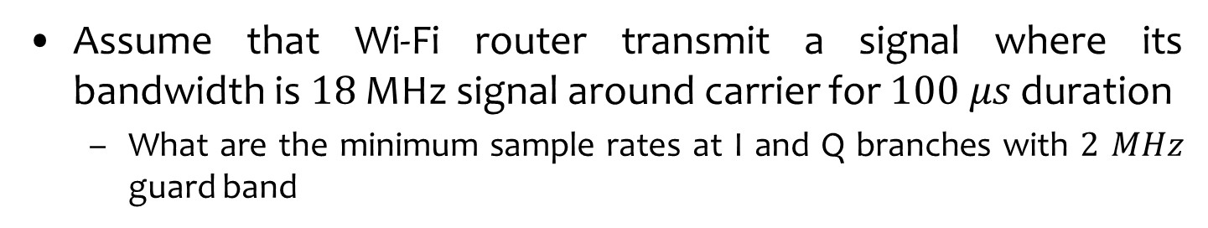



Question 3
Assume that Wi-Fi router transmit a signal where its bandwidth is $18$ MHz signal around carrier for $100 μs$duration
What are the minimum sample rates at I and Q branches with $2$ $MHz$ guard band
$$u\left(t\right)=A\left(t\right)×\cos\left(2πf_{c}t+θ\left(t\right)\right)$$
$$=m_{I}(t)×\cos\left(2πf_{c}t\right)−m_{Q}(t)\sin\left(2πf_{c}t\right)$$
Frequency
$$B$$
Frequency
Frequency
$$B/2$$
$$B/2$$
$$T$$
Time

